Slide 1
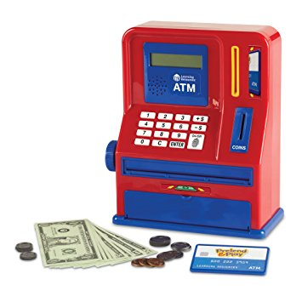
ATM Project
Mary Husain | Michal Porubcin | Andrew Quijano | Bryce Yoo

Slide 2
Overview
Core Functionality
User Interface
Encryption
Database
Online ATM
User Accounts
Tools & Services
Installation
The user interface is kept simple, there are the basics, login, view balance, and deposit/withdraw
Login
Creates session for bank transaction
User can create new account
View Balance
View current amount of money
Deposit/Withdraw
Supports modifying balance and checks if user can withdraw without overdrawing.
The ATM project has built in security features.
AES (Encryption)
Secure and fast symmetric key to encrypt traffic between server and client.
Blowfish (Hashing)
Hide PIN from system admins
Add a layer of authentication when user submits PIN
Future Upgrade
Server Authentication
Client Authentication
This project uses the Heroku Postgre-SQL database
Ease of Usage
Doesn’t require as much effort to set up as building a new MySQL server
Ease of Credentials
Doesn’t require as much effort to set up as building a new MySQL server

Slide 3
Overview
Core Functionality
User Interface
Database
Encryption
Subhead | Subhead | Subhead | Subhead
Users/Services User features ATM Services | Login/Sign up Signup Screen Login Screen | Database Heroku Why it is used How it is used | Supported Security Features AES SHA-256
Code Documentation/Workflow Work Flow Diagram Code Design | Main Interface Login Screen Signup Screen | Database Implementation Tables used Example Subbullet | Hash Function Encryption Blowfish Why it is used Examples
Installation Required Packages | Modify Account Deposit Withdraw | Database View (Can we see it at runtime? | Future Upgrade ATM Server Authentication Client Authentication

Slide 4
Core Functionality
User Accounts
First Name
Last Name
PIN Code
Account Balance
Services
Withdrawals
Multiples of $20
Quick withdrawal options from $20 - $100
Manual for amounts larger than $100
Deposits
Any positive amount (minimum $0.01)

Slide 5
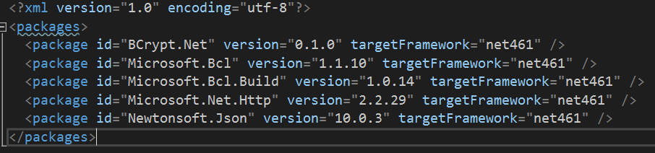
Installation
To install: Create new Project, and select ASP.NET Web Application
Select ASP.NET 4.6.1 Templates, Web Form.
After copying/adding files to solutions, install the following packages (seen in packages.config) using Nuget.

Slide 6
Launch Project
To test our ATM system, simply download the ATM-Web project, build the project, and run on your local machine.
Note: The page may take awhile to load initially because the server (hosted on Heroku) takes a long time to wake up.
Additionally, due to the unfortunate limitations imposed by the free-tier Heroku service, the database is periodically wiped. This should not affect testing in the short term (i.e. any accounts you make should be there immediately after you create them), but if you create an account, then stop interacting with the website for a significant period of time and come back later and try to log in, you may find your account has been erased. There is unfortunately nothing we can do to prevent this.
https://github.com/mari-husain/csharp-atm

Slide 7
Persistent Database
To create a persistent database, you can use the code in atm_backend to create your own locally hosted database API. You'll have to do the following: 1. In the command prompt, navigate to Other/atm_backend.
2. type 'python3' to activate the python3 interpreter.
3. In the interpreter, enter 'from atm_serv import init_db'
4. in the interpreter, enter 'init_db()'
5. In the interpreter, enter 'quit()'
6. In the command prompt, enter 'python3 atm_serv.py'
7. You should see the Flask app boot up in the command prompt window. Please note which port it's running at (likely 5000). Leave it running in this window.
8. In Visual Studio, navigate to Default.aspx.cs.
9. Change line 37 from client.BaseAddress = new Uri("https://atm-backend.herokuapp.com/");
to
client.BaseAddress = new Uri("http://localhost:<port>/");
where <port> is the port number where your flask app is running (i.e. the url would be http://localhost:5000 if the app is running on port 5000).
10. Build and run the webapp as usual. You now have a persistent database.

Slide 8
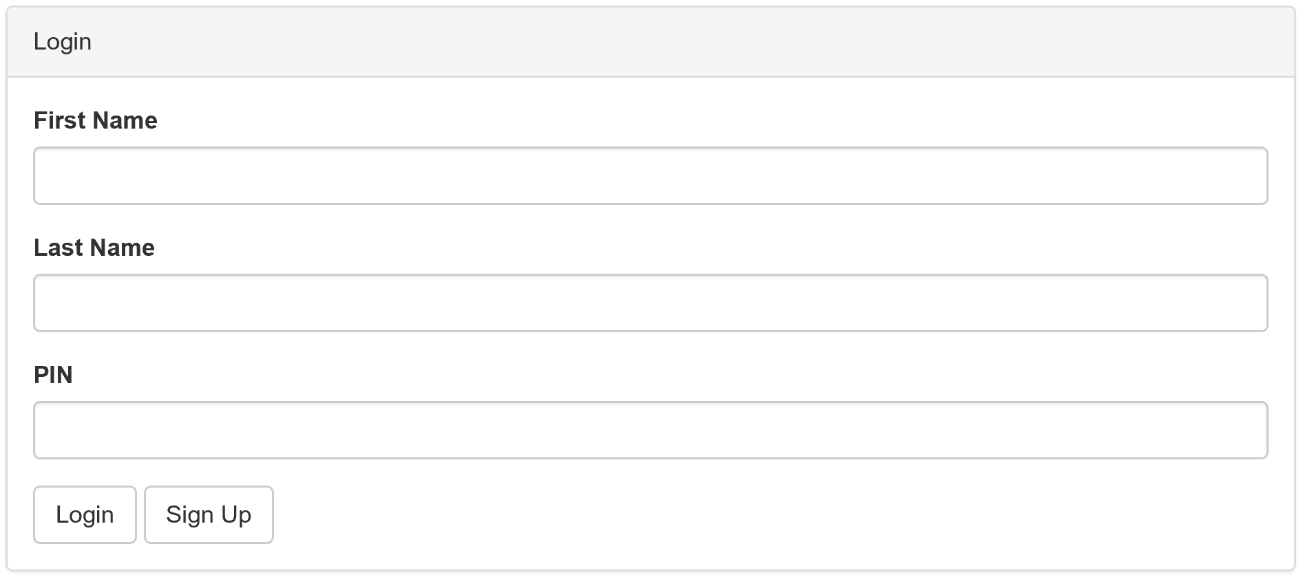
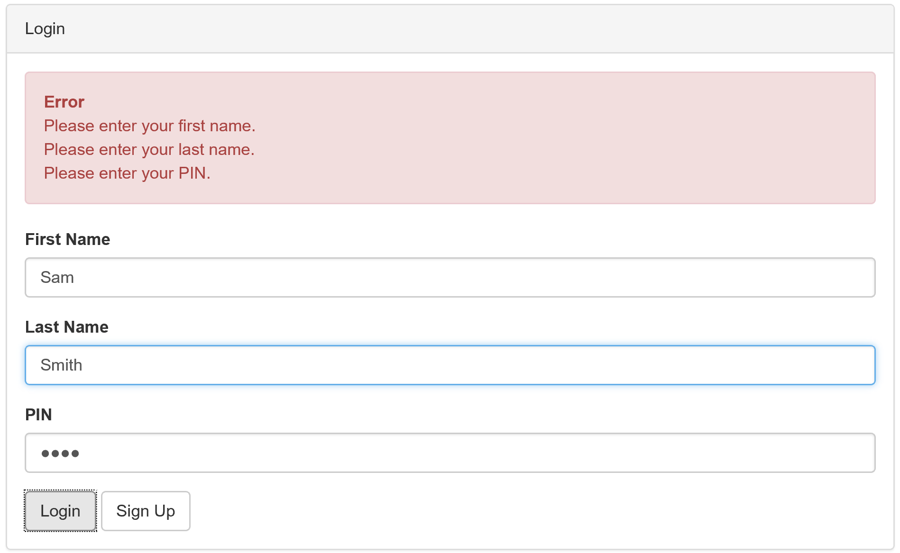
Login Screen and Validation
On the top right is our login page, seen upon starting up the program.
From here you can insert, first name, last name and PIN.
If the user doesn’t have an account, they can click the sign up button

Slide 9
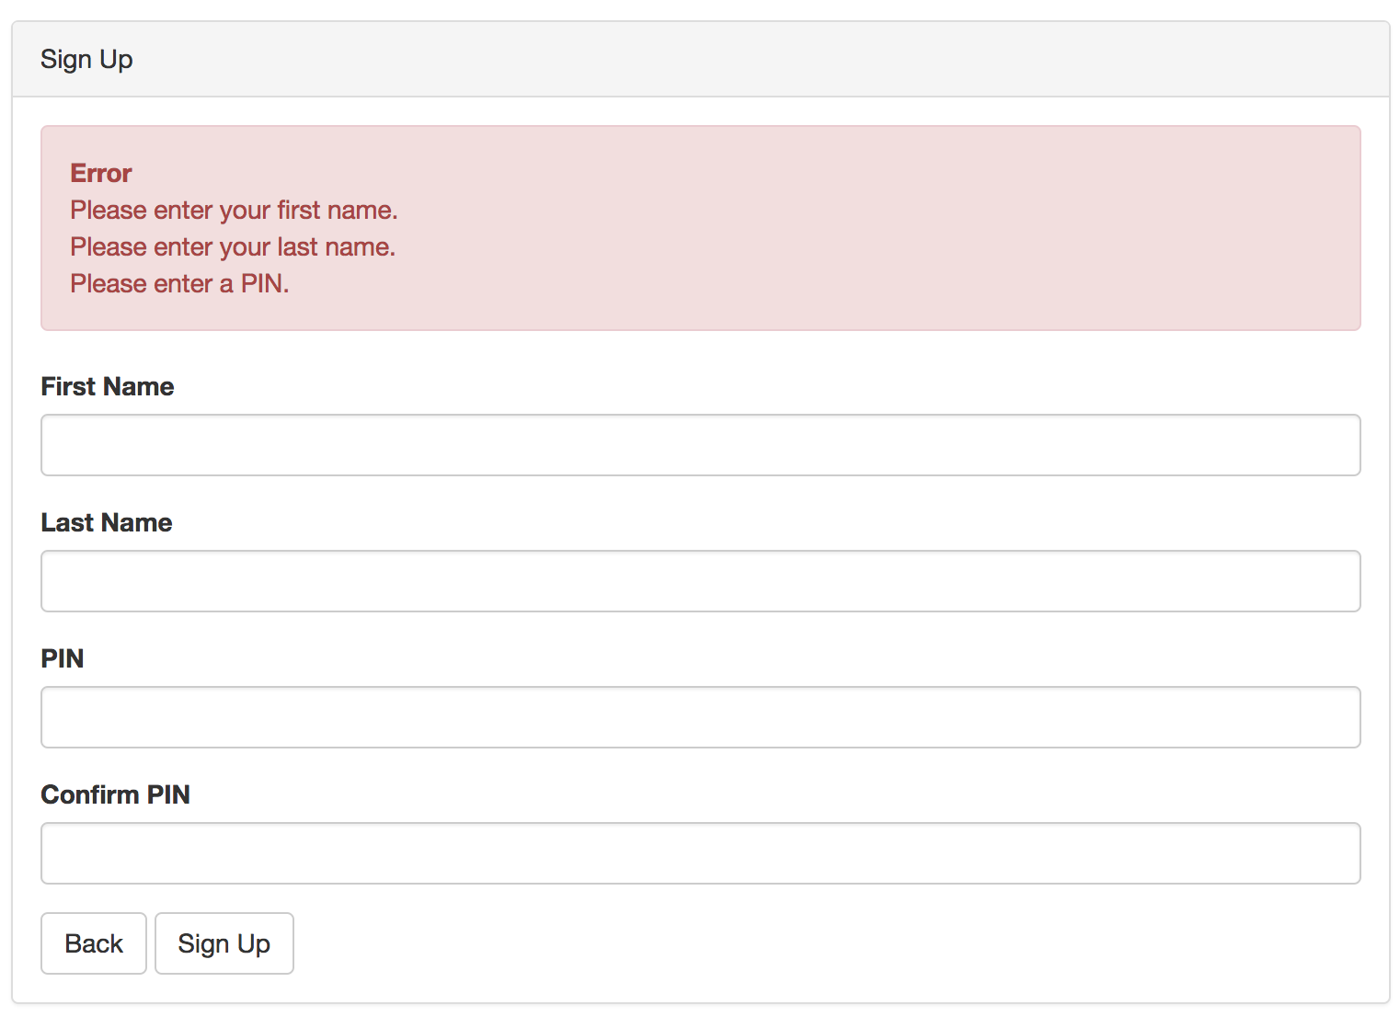
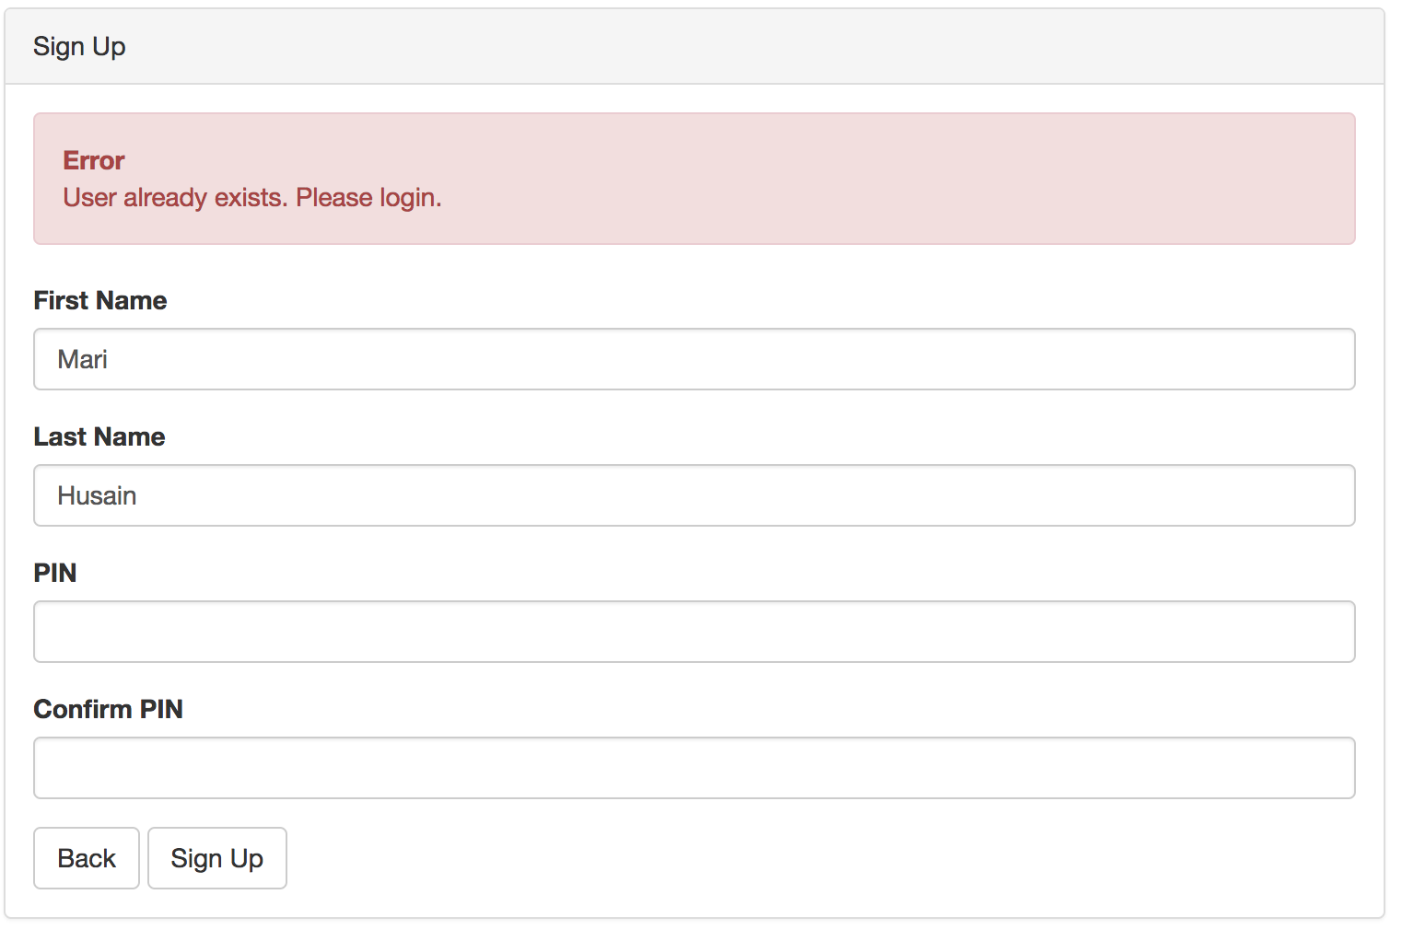
Sign up
To sign up, users need to input their first name, last name and confirm their PIN.
No null values will be accepted (e. g. Mari must have a PIN)
The PIN/Confirm PIN must match
The PIN must consist of numbers, can be any size

Slide 10
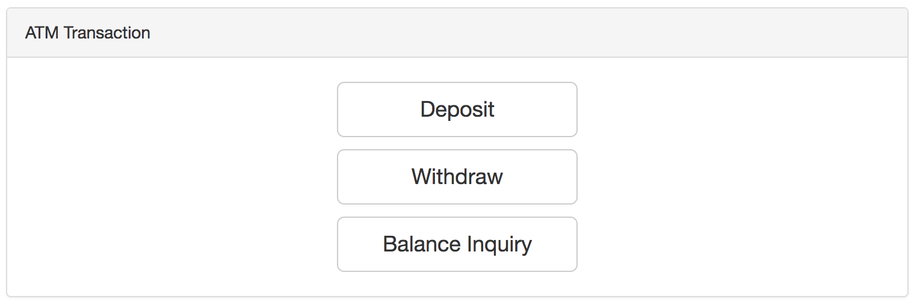
Main Interface
After signing in, the
top banner will contain
the ATM bills in storage
and a logout button
The main interface
connects the user to
the main functionalities
of the ATM.

Slide 11
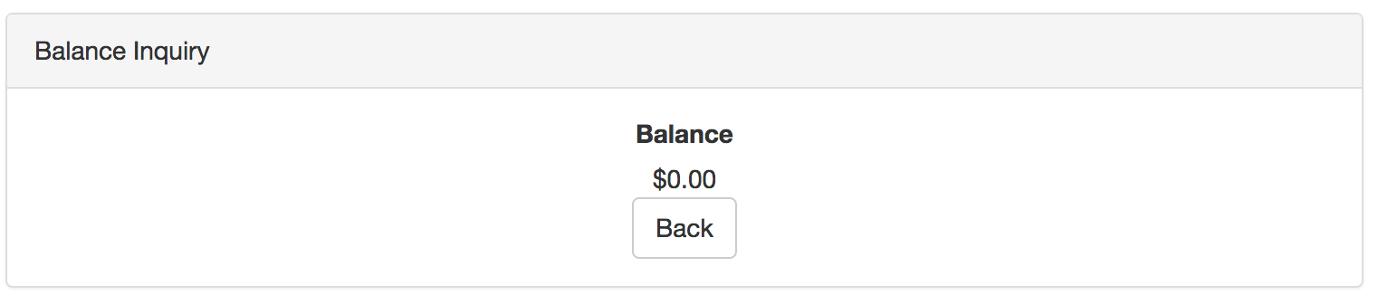
View Balance
The user can view how much money is stored on their account here.
If the user wants to go back to the Main interface, click on
“Back”

Slide 12
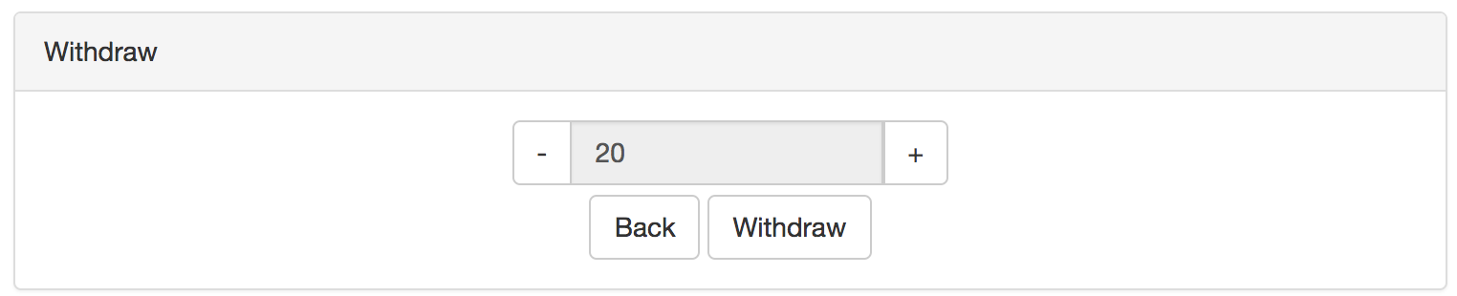
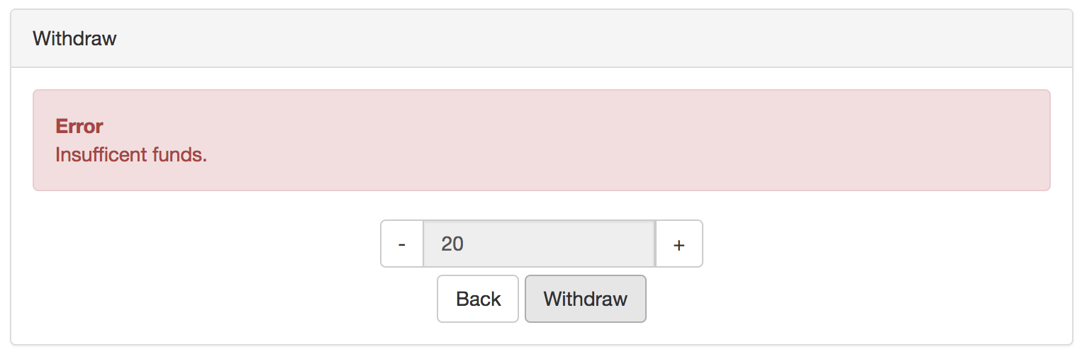
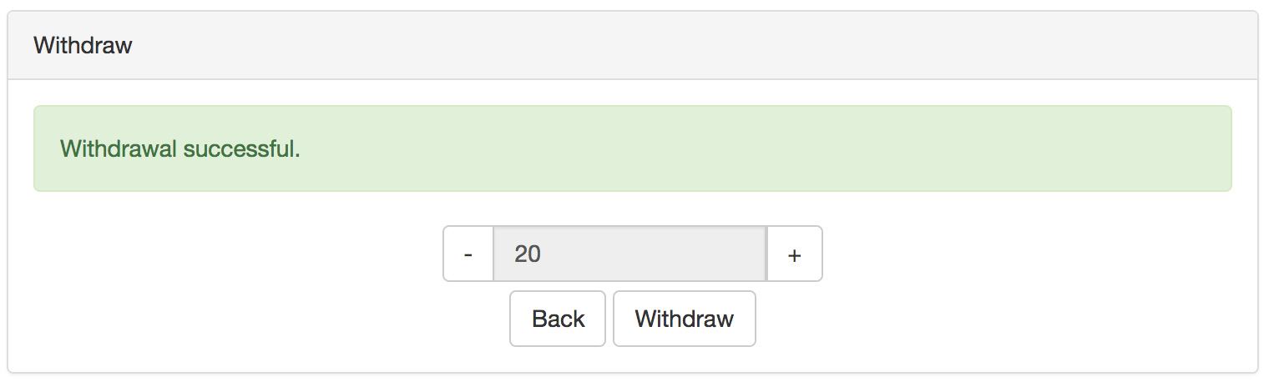
Withdraw
The user can only withdraw increments of $20
The user can’t withdraw more money then in their balance
Once successful, they get a notification on successful withdrawal. The ATM and User balance gets updated

Slide 13
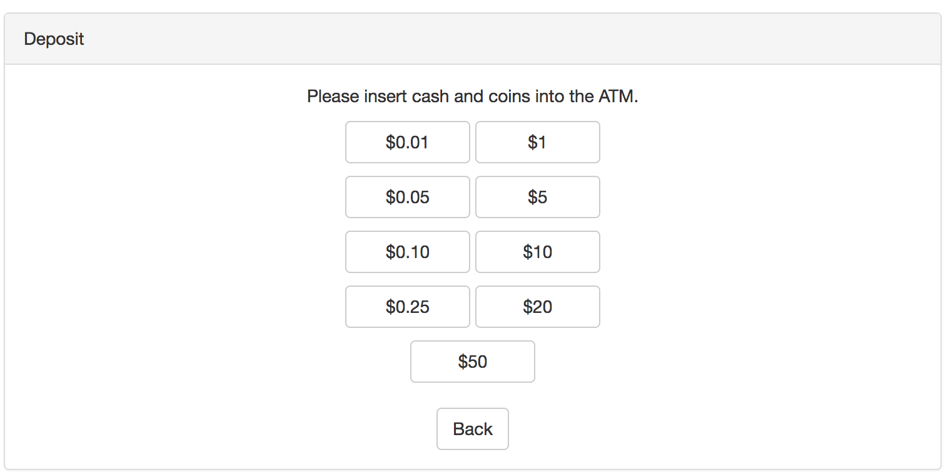
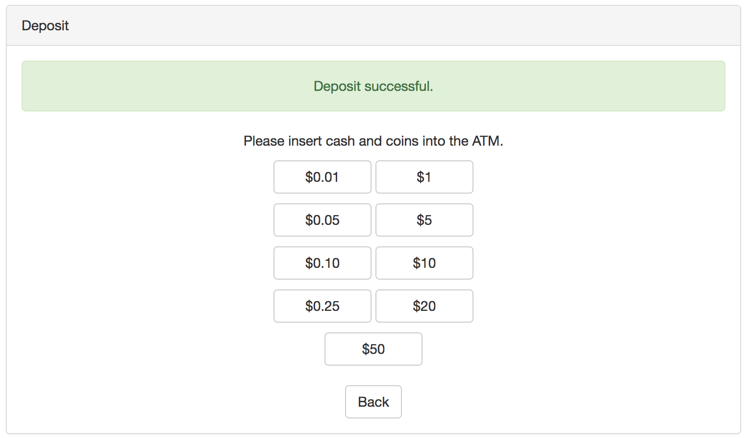
Deposit
A user can deposit one of a denomination. (e. g. 1 $50 bill).
When deposited, you can notice a change in both the user account in View Balance and the ATM reserve when the web page is refreshed

Slide 14
Database
Heroku
Cloud Application Platform based on a managed container system
Platform as a service (PaaS)
Integrated data services and powerful ecosystem
App-centric approach for software delivery
Allows us to build, run and operate our app entirely in the cloud

Slide 15
Database Implementation
See Other/atm_backend/atm_serv.py
Heroku allows for easy set up of the database and uses the same commands as SQL.
The web server would call the predefined SQL queries (using insert, select and update)
Example 1: name_exists is a select query to check if a user already exists on the database
Example 2: create_account uses insert to create the new account on signup screen
Example 3: update uses an update command to update the value of the account Balance

Slide 16
Exploring Encryption Alternatives
Systematic-Key Encryption (e.g. AES)
Hash Function (e.g. SHA, blowfish)
Symmetric Key, permits for encryption and decryption of plaintext
Performance Strength: An AES-128 bit key is faster than public key algorithms like RSA.
Security Strength: An AES is more resistant to quantum computers than RSA.
AES-128 is equivalent to 3072 bit RSA key. An AES-256 key is equal to a 15360 RSA bit key.
Security Weakness: Should the Secret Key be stolen if the Database is hacked, the security benefit of AES is nullified
Security Weakness: AES secret key needs to pre-installed on the client and server. This can be resolved through using the Diffie-Hellman Key Exchange.
Hashing is a one way function that is used for authentication.
Security Strength: A system admin can’t see a PIN in plaintext
Blowfish is roughly equivalent to SHA-256 in strength
Security Strength: robust and resistant brute force attacks
It is difficult to use an array of graphics cards to attempt to find the correct input of a Blowfish Hash
SHA-256 strength/weakness is it can be implemented on GPUs, giving attackers a computational boost
Implementation: simple with Bcrypt
Easy blowflish package for C#
Obtained with Nuget
Add salt to protect against Rainow Tables (pre-computed hashes)

Slide 17
Hash Function Encryption
Deterministic
Pre-image
resistance
Adaptive
function
Secure Online
Teller Machine
Fast block
cipher
Collision
resistance
Small memory
footprint
Password
hashing
function
OpenBSD
Resistant to
rainbow
table attacks

Slide 18
Encryption and Security
Client
User enters PIN
Client hashes the PIN using Blowfish algorithm (with salt)
Client sends [Hashed PIN + salt] to server
Server
Signup: Server stores [Hashed PIN + salt] in database. The original copy is created when a user makes their account.
Login: Server verifies Hashed PIN against value in database

Slide 19
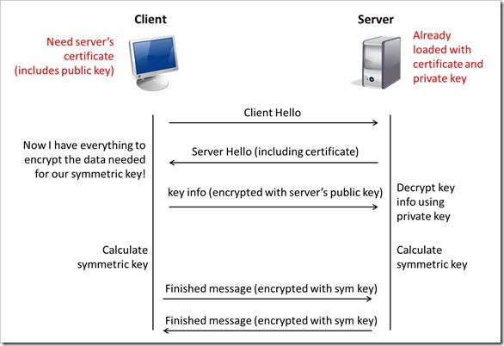
Future upgrades: TLS
We can use TLS and have signed certificates placed on client and server
Server encrypts hash with a Private key. Client decrypts with Public Key.
Since only the server has the private key, it assures the client it is communicating with the server.
Compute AES key using Diffie-Hellman

Slide 20
Work Distribution
Mary Husain
Built the Backend Heroku Database for the ATM
- Set up network communication between front end and backend.
Andrew Quijano
Completed Power Point slides on installation, security, etc.
Completed overall system design and code documentation
Bryce Yoo
Completed PowerPoint outline and half of slides
Designed/wrote front end of webpage
Michal Porubcin
Implemented AES and Hashing to the ATM service
Tested ATM for bugs

